Slide 1
CS3210 Lab 3
GPU Parallel Programming in CUDA
Slides inspired by Sriram's slides

Slide 2
The Burj Khalifa view of CS3210
Part 1: OpenMP
Making single-node CPU programs faster
Complex tasks that are relatively less parallelizable (10s of tasks)
Part 2: CUDA
Making single-node GPU-able programs faster
Simpler tasks that are relatively more parallelizable (millions of tasks even)
Part 3: MPI
Making multi-node programs faster
Large, mixed workloads (slow communication between nodes is worth it due to size / parallelizabilty of work)
You are here!

Slide 3
CUDA is a very deep topic.
We will mainly try to cover the basics - enough!
Highly recommend the CUDA Programming Guide (though not necessary!):
https://docs.nvidia.com/cuda/cuda-c-programming-guide/index.html

Slide 4
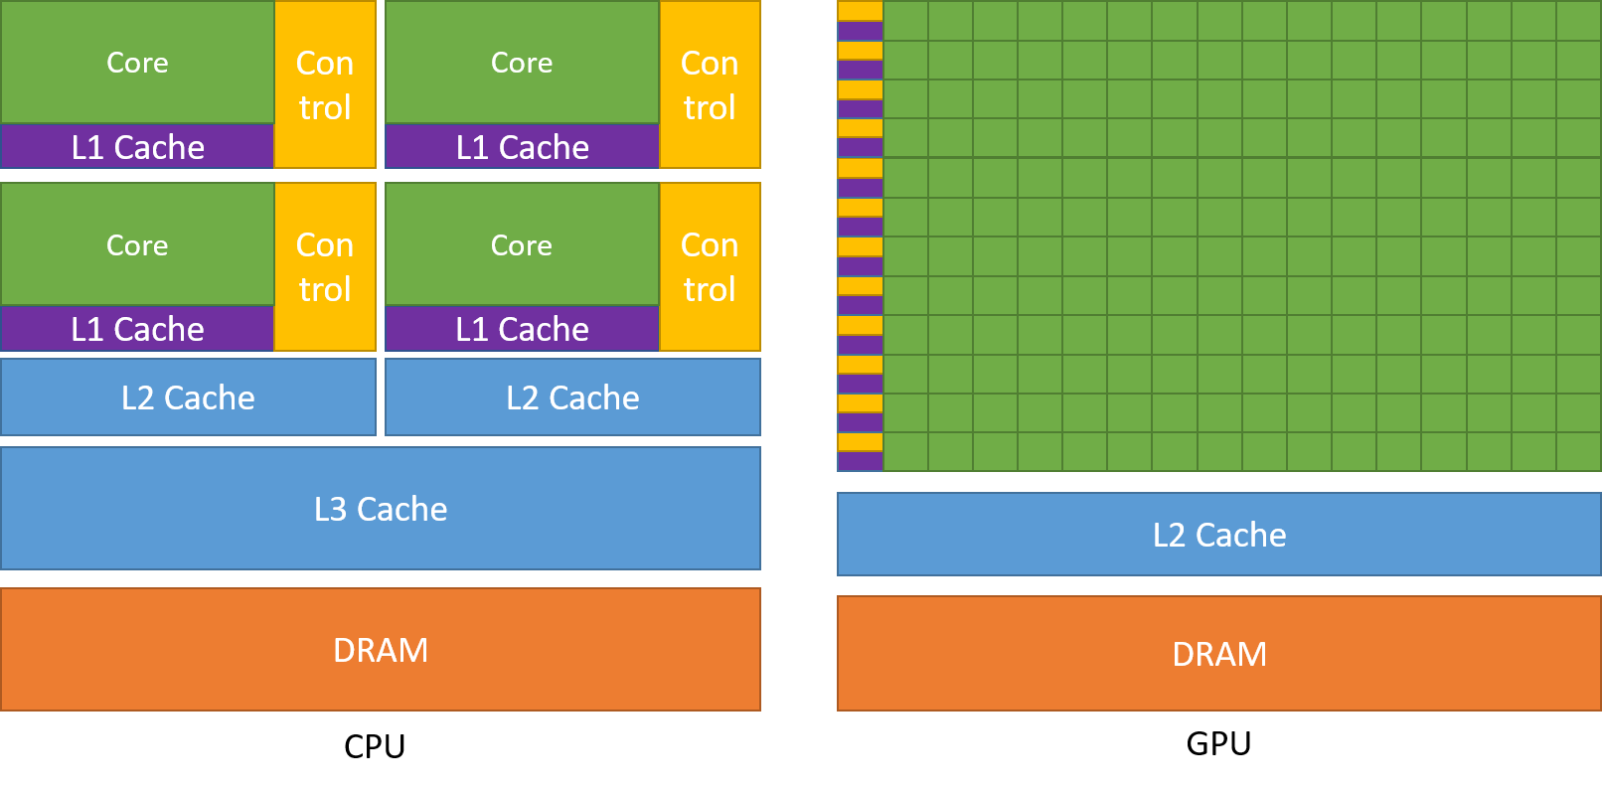
CPU vs GPU: Latency vs Throughput
Complex cores Low latency
Many simple cores High throughput

Slide 5


CPU vs GPU:
CPU
GPU

Slide 6
Main Point:
To maximize CUDA performance, you must understand GPU hardware

Slide 7
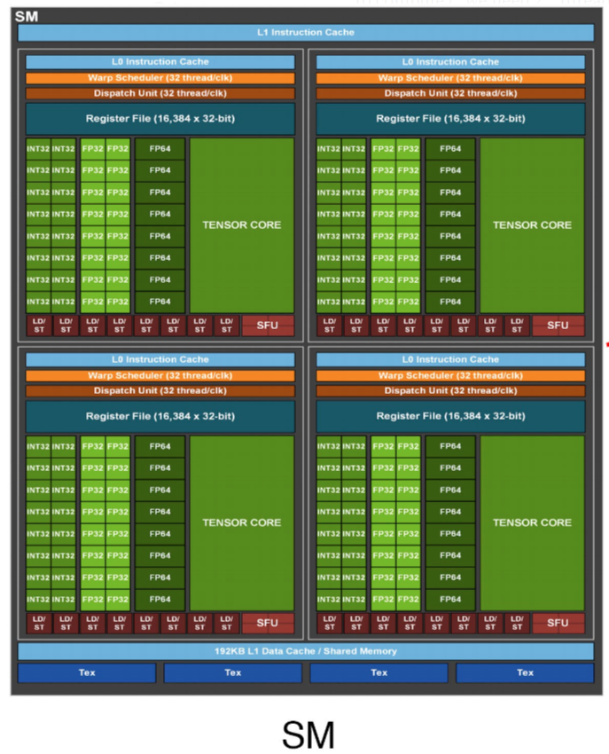
CUDA Physical Structure
GPU: contains many Streaming Multiprocessors (SMs)
Each SM: runs one "thread block" (which contains many threads)
Each SM: runs many warps (groups of 32 threads) in parallel

Slide 8
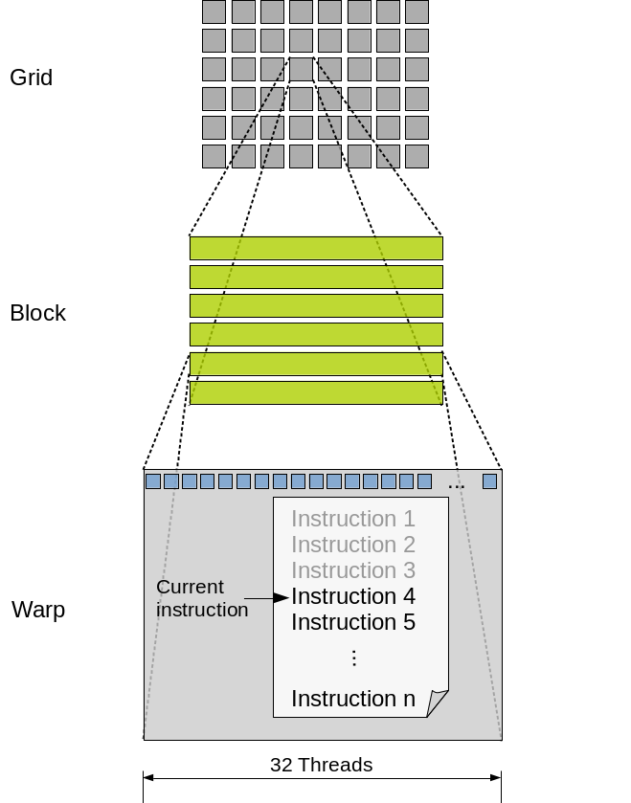
CUDA Logical Hierarchy
A thread executes code on a CUDA core
Specifically, groups of 32 threads (a warp) execute in lockstep in a core.
Threads can be organized in blocks
One block per SM
Blocks are organized into a logical grid
Hardware does not care about grids!

Slide 9
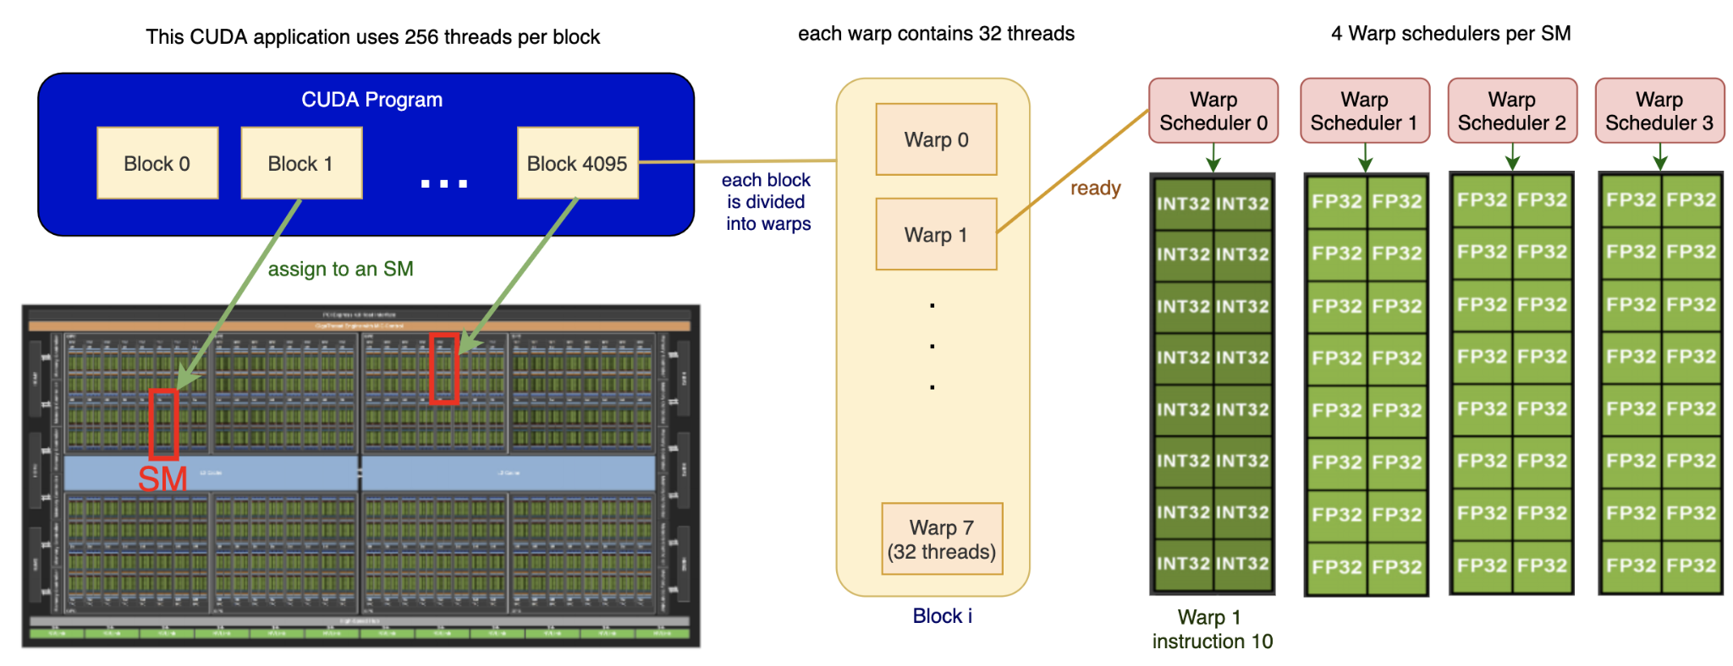
Overview of Physical-Logical Connection

Slide 10
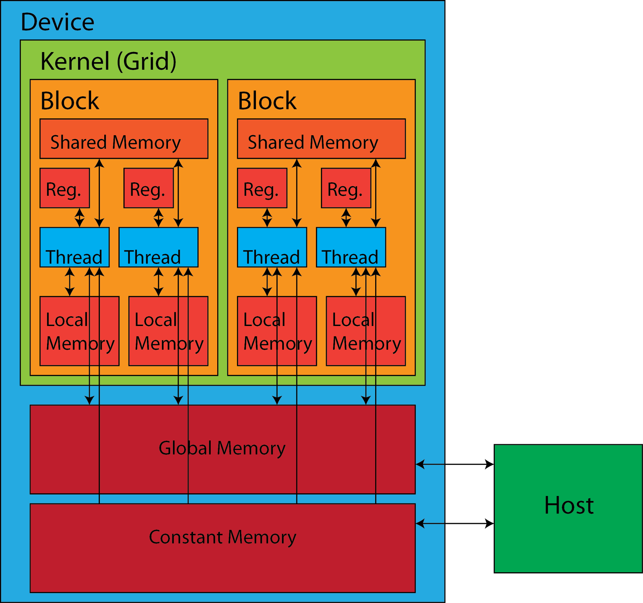
Example optimizations from knowing hardware
Warps are 32 threads, so any block sizes not divisible by 32 have wasted threads (i.e. they run but do no meaningful work)
Keep threads simple and minimize control flow logic (if/else)
Prefer registers > local > shared > global memory

Slide 11
Today's Lab

Slide 12
Good news!
No submission!
But you should still go through it at least once, for assignment 2!

Slide 13
Good news!
We have top-tier GPUs for you to play with!
Node Name | Slurm GPU Name | NVIDIA GPU Name | Compute Capability | Memory | Notes
xgpb[0-2] | p4 | Tesla P4 | 6.1 | 8GB | Does not allocate GPUs properly as of 3 Oct
xgpc[0-9] | v100 | Tesla V100 | 7.0 | 16GB | Does not allocate GPUs properly as of 3 Oct
xgpd[0-9] | titanv | Titan V | 7.0 | 12GB | Does not allocate GPUs properly as of 3 Oct
xgpe[0-11] | titanrtx | Titan RTX | 7.5 | 24GB
xgpf[0-10] | t4 | Tesla T4 | 7.5 | 16GB | Does not allocate GPUs properly as of 3 Oct
xgpg[0-9] | a100 | A100 40GB | 8.0 | 40GB
xgph[0-19] | a100mig | A100 80GB | 8.0 | 80GB | Each A100 80GB node is a NVIDIA Multi-Instance GPU

Slide 14
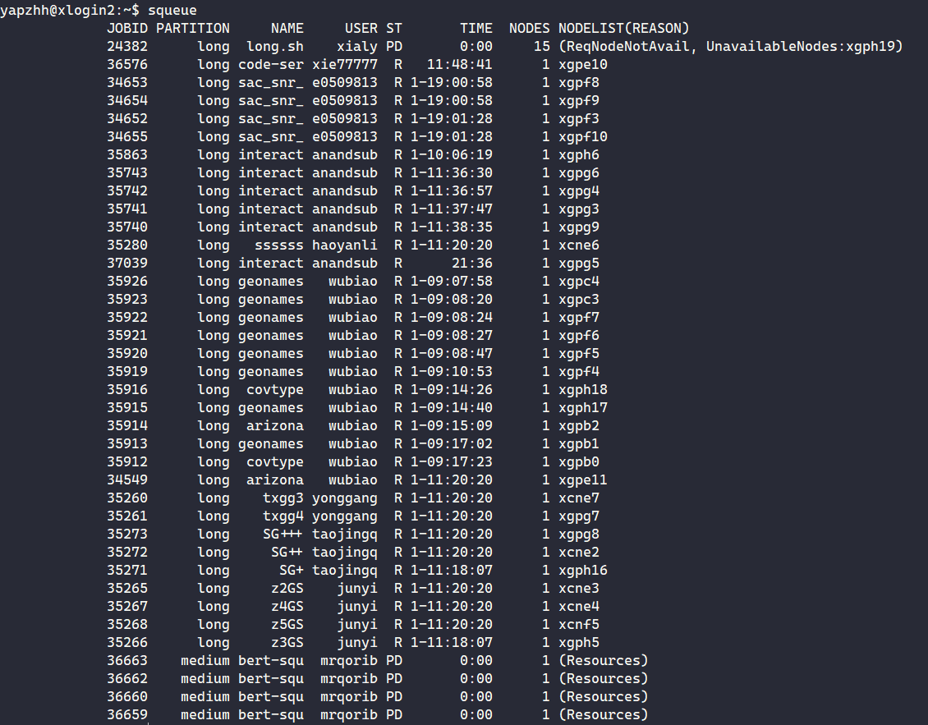
Bad news :(
We have to share with others.
(Currently the cluster is under-utilized, so do let us know if your jobs are not running!)

Slide 15
Login instructions (TLDR)
Ensure you're on FortiClient VPN
ssh <SoC unix username>@xlogin.comp.nus.edu.sg
Test that you can get a GPU via srun --gpus=titanrtx bash -c "hostname; nvidia-smi"
Note: nvidia-smi is only working on titanrtx, a100 and a100mig nodes from my testing…
But you should still be able to run CUDA code on the other nodes!
Your home directory is already synchronized with the GPU nodes, no need to use NFS like soctf-pdc nodes!!

Slide 16
Lab 3 Overview
ex1-4: orientation with xlogin's slurm
ex5: hello world
ex6: calculating thread id (hint later)
ex7-8: understanding warps [demo]
ex9: compile time __device__(global) variables
ex10: cudaMalloc-ed __device__(global) variables
ex11: unified memory with __managed__ [demo]
ex12: shared memory with __shared__
ex13: Atomic memory operations (atomicAdd, etc)
ex14: explicit synchronization [demo]
ex15: putting it together to optimize a simple program
CUDA is very new to you, we generally don't expect you to complete everything within 2 hours.

Slide 17
Note about CUDA executables
CUDA commands (e.g. nvcc, nvprof) is not in $PATH
Cannot just use srun without specifying the full path to the executables i.e. need to specify /usr/local/cuda-12.2/bin/nvcc to compile your code with nvcc
Provided gpu_job.sh script helps you get around that, but you are free to use srun manually if you know what you're doing.

Slide 18
Ex6 hint
https://cs.calvin.edu/courses/cs/374/CUDA/CUDA-Thread-Indexing-Cheatsheet.pdf
(yes, even I referred to the cheatsheet) (mirror uploaded to our Telegram group!)

Slide 19
Ex7: Understanding Warp Divergence & Independent Thread Scheduling

Slide 20
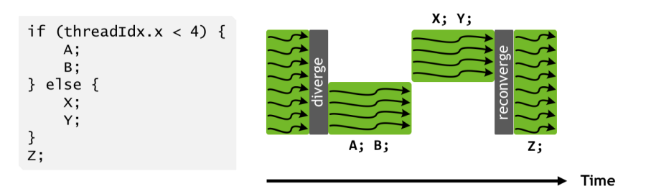
Old: NVIDIA Pascal (<= CC 6.x)
Threads in same warp may diverge under different control flow
Pascal and earlier: entire divergent region must converge first.

Slide 21
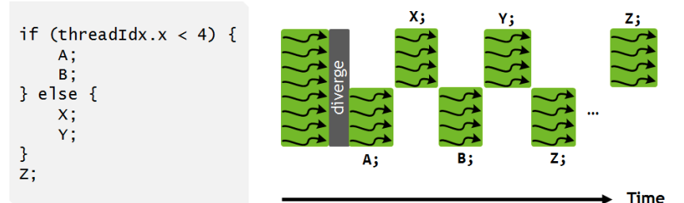
New: NVIDIA Volta (>= CC 7.x)
Independent thread scheduling (ITS)
Different statements in the divergent branches can interleave
New >=CC 7.x
Old <=CC 6.x

Slide 22
Demonstrating issues with divergence
vim its_share.cu
srun --gpus=a100 bash -c "/usr/local/cuda-12.2/bin/nvcc -o its_s_70 --std=c++17 -arch sm_70 -O0 -Xptxas -O0 its_share.cu; ./its_s_70"
srun --gpus=a100 bash -c "/usr/local/cuda-12.2/bin/nvcc -o its_s_50 --std=c++17 -arch sm_50 -O0 -Xptxas -O0 its_share.cu; ./its_s_50"
Don't mind the long commands
Notes:
srun --constraint xgpb --gres=gpu:1 bash -c "/usr/local/cuda-12.2/bin/nvcc -o its_s_50 --std=c++17 -arch sm_50 -O0 -Xptxas -O0 its_share.cu; ./its_s_50"

Slide 23
Observations
Not much difference in runtime between different CC versions!
Control flow divergence within warps can cause slowdowns.
Divergence between warps does not have an issue.

Slide 24
Ex11: Unified Memory

Slide 25
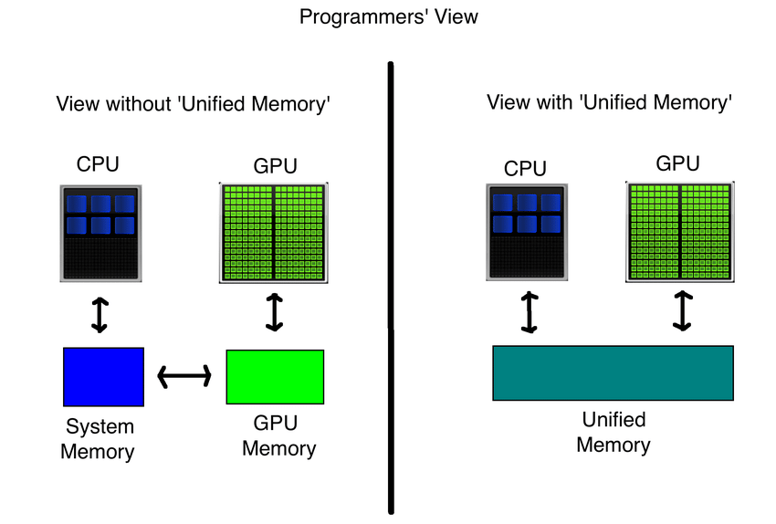
Unified Memory

Slide 26
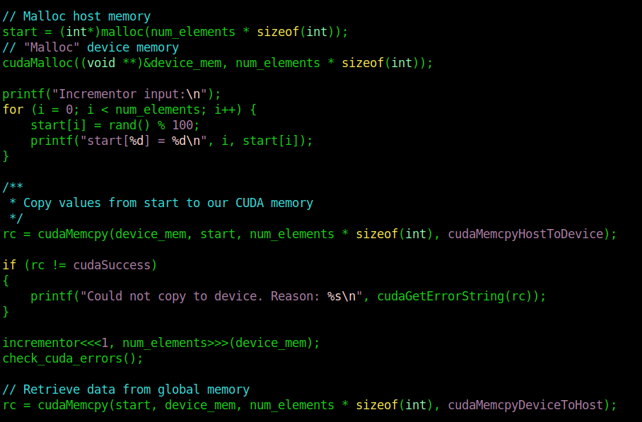
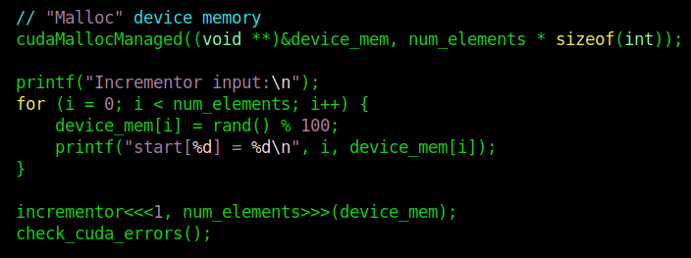
Unified Memory
Normal
Unified

Slide 27
Why not used unified memory always?
vim unified.cu
srun --gpus=titanrtx bash -c "/usr/local/cuda-12.2/bin/nvcc -o unified -std=c++17 -arch sm_70 -Xptxas -O0 unified.cu; ./unified"

Slide 28
Why not used unified memory always?
vim unified.cu
srun --gpus=titanrtx bash -c "/usr/local/cuda-12.2/bin/nvcc -o unified -std=c++17 -arch sm_70 -Xptxas -O0 unified.cu; ./unified"
Unified is slightly slower! But much easier to program.

Slide 29
Ex14: Volatile Variables

Slide 30
Volatile
Why is is_done volatile? srun --gpus=titanrtx bash -c "/usr/local/cuda-12.2/bin/nvcc -o synchronize_wrong -std=c++17 -arch sm_70 -Xptxas -O0 synchronize_wrong.cu; ./synchronize_wrong"

Slide 31
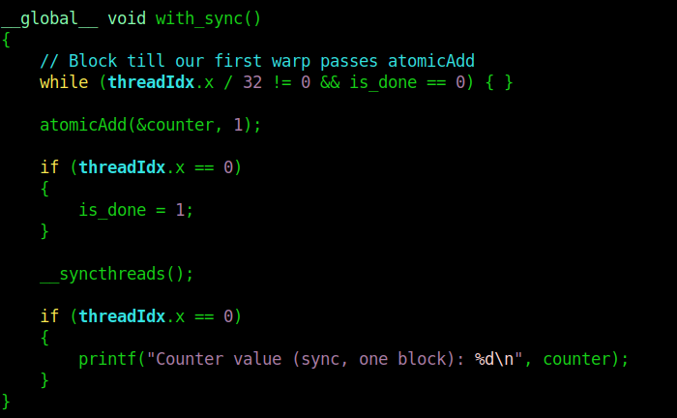
Volatile
Why is is_done volatile?
Without volatile, compiler will optimize is_done into a per-thread private register
Thread A may not see the fact that Thread B set is_done = 1!

Slide 32
Performance Profiling

Slide 33
Performance Profiling
The greatest sin of optimization: optimization without profiling
How to profile CUDA applications?
nvprof / NVIDIA Visual Profiler (deprecated past CC 7.5!)
Now: ncu (NVIDIA Compute CLI, for kernels) and nsys (NVIDIA NSight Compute, general profiler)
Read: https://gpuhackshef.readthedocs.io/en/latest/tools/nvidia-profiling-tools.html
Examples
nvprof ./sum_ans_short
nsys profile -o sum_ans_short ./sum_ans_short
nsight-sys
ncu ./sum_ans_short
ncu is a little broken on SoC cluster for now - necessary for kernel profiling

Slide 34
End of Lab 3
Slides are uploaded here after every session GDrive: drive.zhiheng.dev
Anonymous Feedback: feedback.zhiheng.dev
All the best for midterms!

